Slide 1
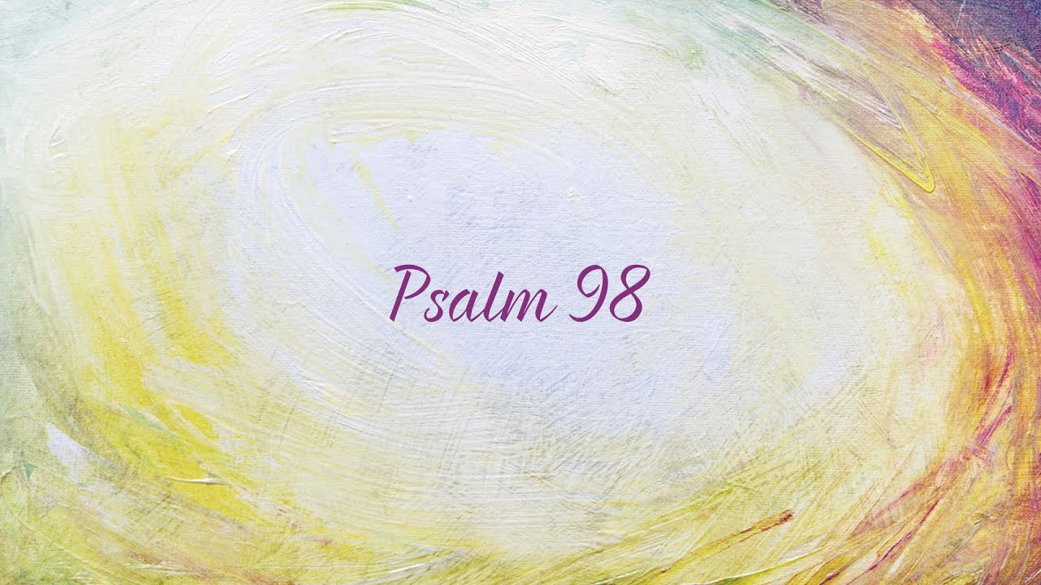
O sing to the LORD a new song…
August 28, 2022

Slide 2
Psalm 98 (LSB)
A Psalm
1 Sing to Yahweh a new song, For He has done wondrous deeds, His right hand and His holy arm have worked out His salvation. 2 Yahweh has made known His salvation; He has revealed His righteousness in the eyes of the nations.
3 He has remembered His lovingkindness and His faithfulness to the house of Israel; All the ends of the earth have seen the salvation of our God. 4 Make a loud shout to Yahweh, all the earth; Break forth and sing for joy and sing praises. 5 Sing praises to Yahweh with the lyre, With the lyre and the sound of singing. 6 With trumpets and the sound of the horn Make a loud shout before King Yahweh.
7 Let the sea roar, as well as its fullness, The world and those who dwell in it. 8 Let the rivers clap their hands, Let the mountains sing together for joy 9 Before Yahweh, for He is coming to judge the earth; He will judge the world with righteousness And the peoples with equity.

Slide 3
The might of the Lord ^{(98:1-2)}
The song of the Lord (1a)
The strength of the Lord (1b)
The salvation of the Lord (2)

Slide 4
The Mercy of the Lord ^{(98:3-6)}
The remembrance of God’s mercy (3)
The results of God’s mercy (4-6)

Slide 5
The majesty of the Lord ^{(98:7-9)}
The jubilation of the Earth (7-9a)
The judgment of the Earth (9b)
The Lord will rule faithfully
The Lord will reign fairly

Slide 6
O sing to the LORD a new song…
August 28, 2022

